Slide 1
Caption Generator
Guide Name: Dr. S Thenmozhi Vijaykumar R Pai
Associate Professor, Dept. of CA PES1201702013
PES University

Slide 2
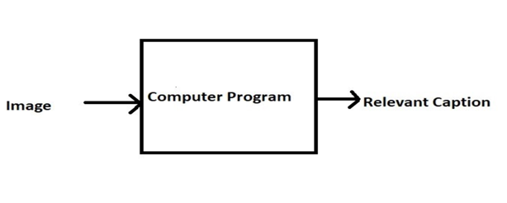
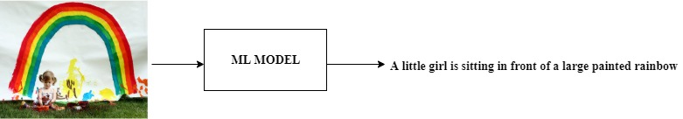
ABSTRACT
Caption Generator is a Machine Learning application which identifies the action portrayed in the given image.
The generated caption will describe about the image which will say what kind of actions is taking place in it.

Slide 3
TOOLS AND TECHNOLOGIES
Frontend: HTML, CSS, Bootstrap
Backend: Flask 1.x
Language: Python 3.7
Storage (Dataset): AWS S3 Bucket
IDE: Jupyter Notebook

Slide 4
MODULES
Data Gathering
Images for training the model
Corpus for Image captions
Object identification
Feature extraction from images
Model Generation using CNN
Building LSTM (Long Short Term Memory) model.
Validating the Model
Development of web application.
Deploy the ML model in the web application

Slide 5
APPLICATION IN THE REAL WORLD
If the caption is converted to speech it will be helpful for the visually impaired person
Auto subtitling

Slide 6
THANK YOU

